Slide 1


AI for Minecraft
Shaohong Tian Jiahao Yu Guo Zhou Ziwei Li
May, 2018

Slide 2



Problem Description
1 Description of research problems
2 Experiments for research problems
3 Current conclusions
4 Challenges in experiments
Notes:
Our presentation will show these four parts, the research problem, experiments, results so far and challenges. Shaohong Tian and will introduce the first proposal, Jiahao Yu and Guo Zhou will introduce the second proposal, and show us the conclusion so far.

Slide 3
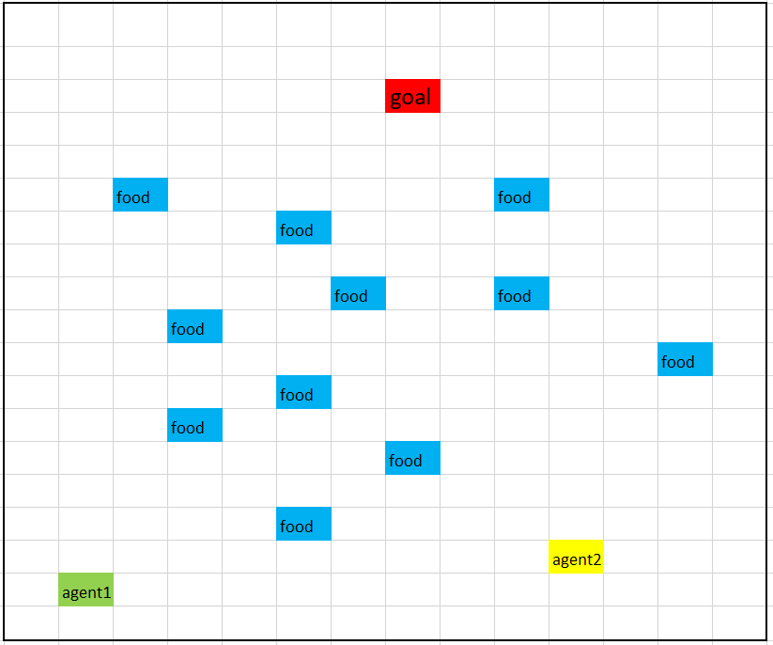
Problem Description
Two agents work together to get all resources first and then reach to the goal point
Notes:
we have two agents in this project. the main goal is to collect all the resources (like the blue food part) and then, let one of the agent get into the final point as the red goal in this picture.

Slide 4
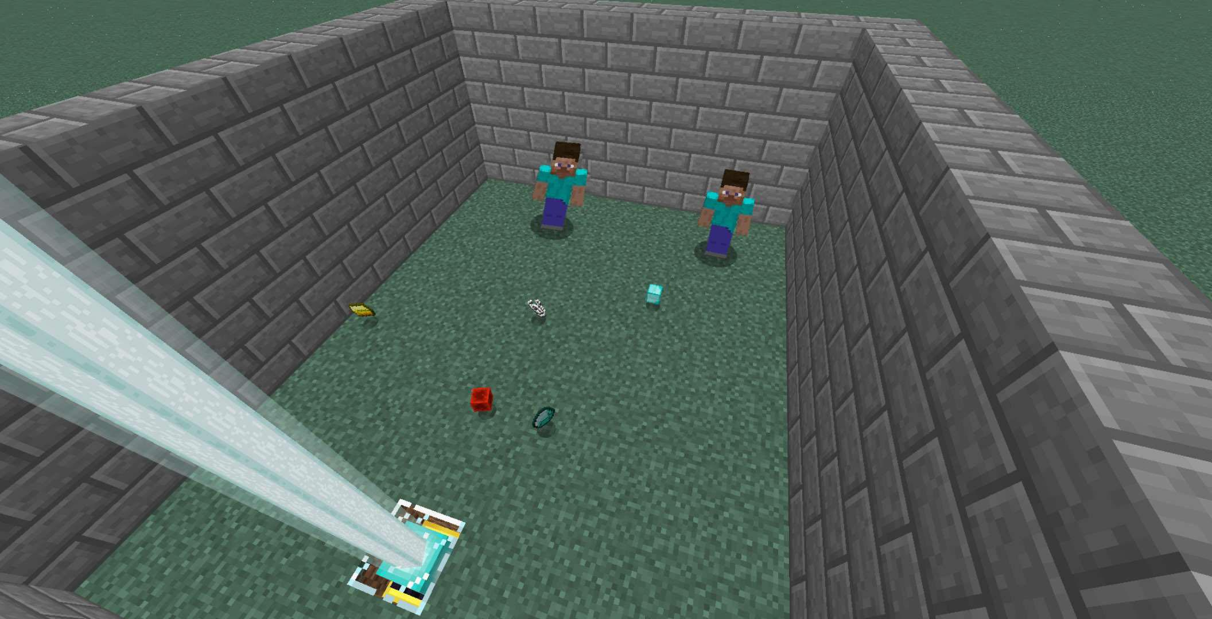
Problem Description
Notes:
And this is a picture that how it actually works.

Slide 5
Research Proposal
Proposal 1:
The performance of Double Q-learning is better than that of Q-learning
Definition of performance:
The distribution of Q values in QL and DQL
Rate of convergence in QL and DQL
Proposal 2 :
In the project with multiple agents, the performance of the Dynamic programming is better than greedy algorithm used in resource allocation plan.
Definition of performance:
Training time
Minimum number of steps
Notes:
How can the agents find its way, we can use some algorithms, while in this project, we choose Q LEARNING and thinking about if double Q learning may works better or not.. SO THE first One is to compare the performance by using Q learning and double Q learning. By observing the distribution of Q value and rate of convergence. We can find which algorithm is better depends on different situations.
Another proposal we thought is should we use dynamic plan or fix task allocation at the beginning of program. We can compare the performance of two methods. What’s more, the training time is also an important factor we considered.
Now my friends will explain the proposal in details.

Slide 6
Research Proposal
Proposal 1:
The performance of Double Q-learning is better than that of Q-learning
Definition of performance:
The distribution of Q values in QL and DQL
Rate of convergence in QL and DQL
Notes:
Hi, I will be introducing the first proposal, the first proposal we proposed is that we think the performance of double-q learning is better than q-learning. Ans for the definition.of performance, we will.focus on the distribution of q values and the concergent rate

Slide 7
Overestimate
Take maximum value over all actions
Q values are noisy
Overestimate
Hado van Hasselt
Notes:
before i introduce the concept of double qlearning, let’s review qlearning algorithms. In qlearning, in this case,we have a grid for the map. we have several actions,we have move south, move north. move east, move west, and we choose the coordinator and the action as the states, and the qtable stores the q value of each states. In qlearning approach , we select the action that have the maximun qvalue as a next step, and update the current q value. But beacuse the qvalues are noisey, thus the max value we get is noisey, so qlearning will overestimate. Sometimes it visit the state that you think is useful, but actually not, so it will waste lots of time. To address this problem, Hado van hasselt introduce a new algorithm called double qlearning,

Slide 8
Update function
QL:
Q(s,a) = Q(s, a) + α(s, a)(r +γQ(s′, a∗) − Q(s, a))
DQL:
Q^{A}(s,a) = Q^{A}(s, a) + α(s, a)(r +γQ^{B}(s′, a∗) − Q^{A}(s, a))
Q^{B}(s,a) = Q^{B}(s, a) + α(s, a)(r +γQ^{A}(s′, a∗) − Q^{B}(s, a))
Notes:
So in double q learning, we have two tables, table a and table b,we randomly choose one to decide the aciton we use, and use the other table to calculate the value. As we can see in the equation, qlearning use it’s own value to upate the qvalue, but double qlearing use the other table to update the value,. So the chance that the two table both overestimate the same action is very low. Thus we can solve the overestimate proble,

Slide 9
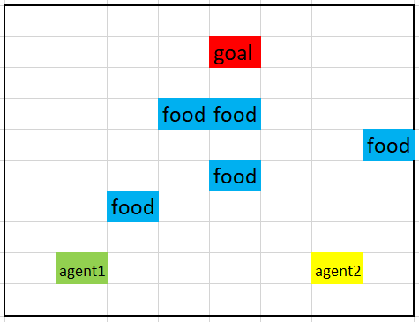
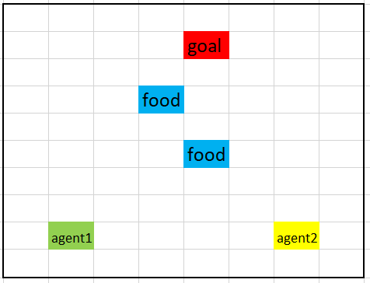
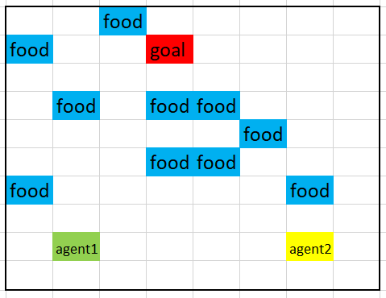
Experiments
Four kinds of experiments (each kind of experiment has several sub-experiments corresponding to projects with different difficulty degrees) :
 | Greedy approach before execution | Dynamic approach in execution
Use Q-Learning to train agents | ✔ | ✔
Double Q-Learning to train agents | ✔ | ✔
Difficulty degree: Easy
Difficulty degree: Normal
Difficulty degree: Hard
Notes:
In order to verify our proposal, we set up four experiments, we can just focus on the comparision of the same coloumn, the rows are for the second proposal,. and for each eperiment , we have three different difficult level map, as you can see, the number of resouces are increasing.

Slide 10
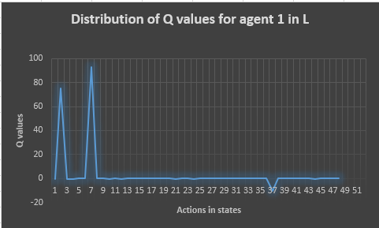
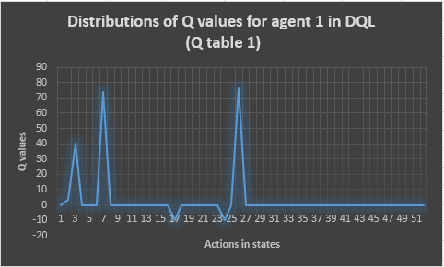
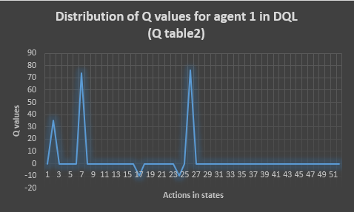
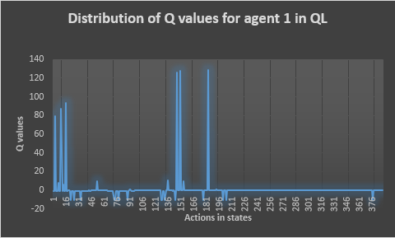
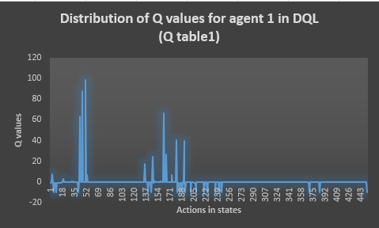
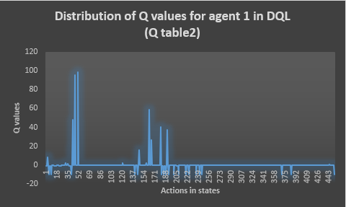
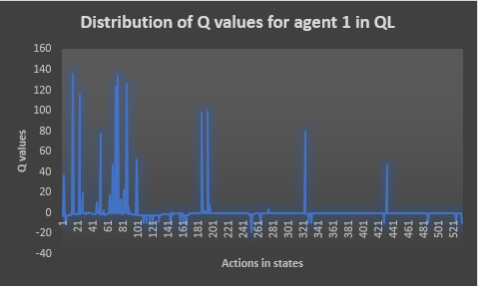
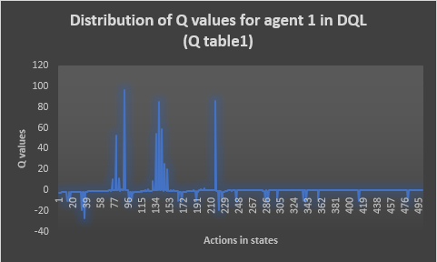

Data analysis — Distribution of Q values
Q-Learning + Greedy approach VS Double Q-Learning + Greedy approach
Easy
Normal
Hard
Notes:
As for the result, we draw a q value distrubution chart, we can see that, the qvalue of using qlearning are much higher that using double qlearing, and beacuse we choose tablea and table b in double q learing randomly, the distribution of these two tables are mostly the same.

Slide 11
Data analysis —Rate of convergence
Least training times for convergence:
 | Q-Learning + Greedy approach | Double Q-Learning + Greedy approach
Easy | 48 times | 69 times
Normal | 186 times | 327 times
Hard | 578 times | 954 times
Notes:
As for the speed of covergence, as for our traing, the double q learning required longer time to congerge, we think that’s maybe that the double q learing have to update two tables, that takes time, and the other reason might beacuse that the map we are using are not complex enough, so the overestimate problem are not so obvious. thus convergent rate is lower than q learning

Slide 12
Current conclusions for problem 1
Conclusion 1: The Q values in QL are generally higher than those in DQL.
Conclusion 2: The rate of convergence in QL is higher than that in DQL.
Notes:
So that’s our two conclusion, the frist is the qvalue in qlearnign are higher than in double q learning, but the convergent rate in q learing is higher that doubel q learning. Based on our data, we can’t say that double qlearning are better than q learning, but we decide to use more complex maps to verify this.

Slide 13
Research Proposal
Proposal 2 :In the project with multiple agents, the performance of the Dynamic programming is better than greedy algorithm be used in resource allocation plan
Definition of performance:
Training times
Minimum number of steps

Slide 14
Data analysis — Shortest time of the training process
Average shortest time of the training process :
 | Dynamic programming plan + QL | Greedy algorithm plan + QL
Simple | 58 times | 48 times
Medium | 247 times | 186 times
Hard | 754 times | 578 times

Slide 15
Data analysis —Efficiency of finishing task
Dynamic programming plan + QL VS Greedy algorithm plan + QL
easy
9 steps
9 steps
12 steps
15 steps
normal

Slide 16
Data analysis —Efficiency of finishing task
Dynamic programming plan + QL VS Greedy algorithm plan + QL
easy
9 steps
9 steps
12 steps
15 steps

Slide 17
Data analysis —Efficiency of finishing task
Dynamic programming plan + QL VS Greedy algorithm plan + QL
13 steps
hard
19 steps

Slide 18
Current conclusions for proposal 2
Conclusion:
The dynamic programming:
need more training time
use fewer steps to get the goal
.
The performance of finding a shorter paths is more important for our project, so this proposal is right.!
Notes:
The University of Melbourne Records Retention and Disposal Authority (RDA) is
“…the University document that sets out requirements for retention and disposal of all types of records, in line with legislative requirements and University business needs…”
(Records Management Policy MPF1106)
Records Services is responsible for developing the RDA
The University Archivist, Legal Services and the Director, Internal Audit are also consulted
The final document is approved by the University Secretary
(Records Management Policy MPF 1106, Records Retention and Disposal Procedure MPF1109)

Slide 19
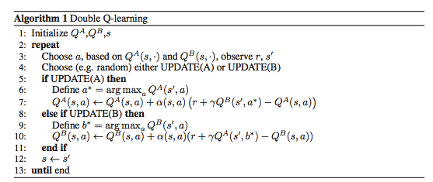
Challenges
Challenge 1:
How to decide the probability of updating Q table 1 or Q table 2 in implementing double Q- learning (or the probability of taking action based on Q table 1 or Q table 2)?
Solution:
Try a series of probabilities and see which probability can make that the distribution of Q values in two tables is similar
Notes:
The University of Melbourne Records Retention and Disposal Authority (RDA) is
“…the University document that sets out requirements for retention and disposal of all types of records, in line with legislative requirements and University business needs…”
(Records Management Policy MPF1106)
Records Services is responsible for developing the RDA
The University Archivist, Legal Services and the Director, Internal Audit are also consulted
The final document is approved by the University Secretary
(Records Management Policy MPF 1106, Records Retention and Disposal Procedure MPF1109)

Slide 20
Challenges
Challenge 2:
How to implement dynamic planning ?
Solution: Take the project of normal difficulty as an example for explaining
project of medium difficulty
Notes:
The University of Melbourne Records Retention and Disposal Authority (RDA) is
“…the University document that sets out requirements for retention and disposal of all types of records, in line with legislative requirements and University business needs…”
(Records Management Policy MPF1106)
Records Services is responsible for developing the RDA
The University Archivist, Legal Services and the Director, Internal Audit are also consulted
The final document is approved by the University Secretary
(Records Management Policy MPF 1106, Records Retention and Disposal Procedure MPF1109)

Slide 21
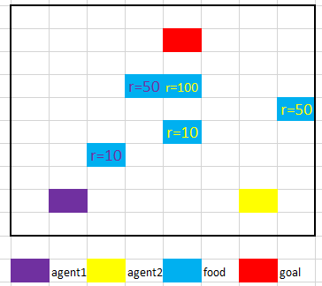
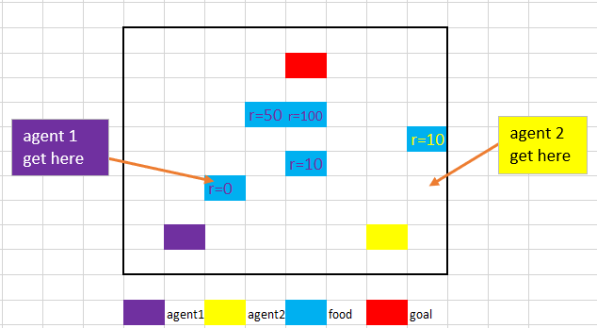
Challenges
Dynamic planning
Before each episode of training , allocate which foods should be got by which agent based on the distance from agents` initial position to foods. The rewards of these foods will be set based on this distance as well.
In the process of each episode of training, Every time when one agent gets a food, allocate again which foods should be got by which agent based on the distance from agents` current position to existed foods. The reward of these foods will be set again based on this distance as well.
Notes:
The University of Melbourne Records Retention and Disposal Authority (RDA) is
“…the University document that sets out requirements for retention and disposal of all types of records, in line with legislative requirements and University business needs…”
(Records Management Policy MPF1106)
Records Services is responsible for developing the RDA
The University Archivist, Legal Services and the Director, Internal Audit are also consulted
The final document is approved by the University Secretary
(Records Management Policy MPF 1106, Records Retention and Disposal Procedure MPF1109)

Slide 22
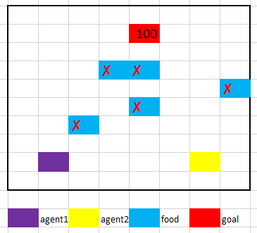
Challenges
Continue the last slide:
The reward of the final goal will be set just when all foods are got
Notes:
The University of Melbourne Records Retention and Disposal Authority (RDA) is
“…the University document that sets out requirements for retention and disposal of all types of records, in line with legislative requirements and University business needs…”
(Records Management Policy MPF1106)
Records Services is responsible for developing the RDA
The University Archivist, Legal Services and the Director, Internal Audit are also consulted
The final document is approved by the University Secretary
(Records Management Policy MPF 1106, Records Retention and Disposal Procedure MPF1109)

Slide 23
Thanks
Thanks to professor Nir Lipovetzky and professor Tim Miller very much for the help they give us in this project
Notes:
The University of Melbourne Records Retention and Disposal Authority (RDA) is
“…the University document that sets out requirements for retention and disposal of all types of records, in line with legislative requirements and University business needs…”
(Records Management Policy MPF1106)
Records Services is responsible for developing the RDA
The University Archivist, Legal Services and the Director, Internal Audit are also consulted
The final document is approved by the University Secretary
(Records Management Policy MPF 1106, Records Retention and Disposal Procedure MPF1109)

